Slide 1



Premium Experience for Customers
Hackathon
=
Time For A Change

Slide 2
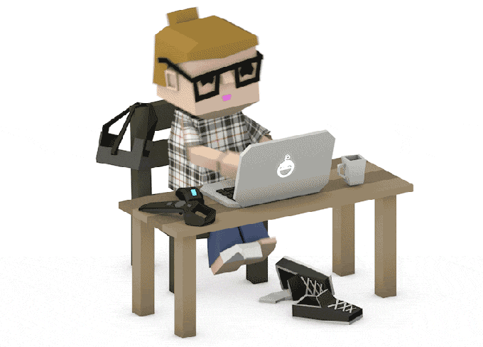
We are
force!
Extreme Programming Pairs
{ Abhishek Srivastava, Rohan Datta }
{ Divya Raj, Simran Srivastava }
Mentor
{ Mr Krishna }
Notes:
Adaptability than on predictability

Slide 3

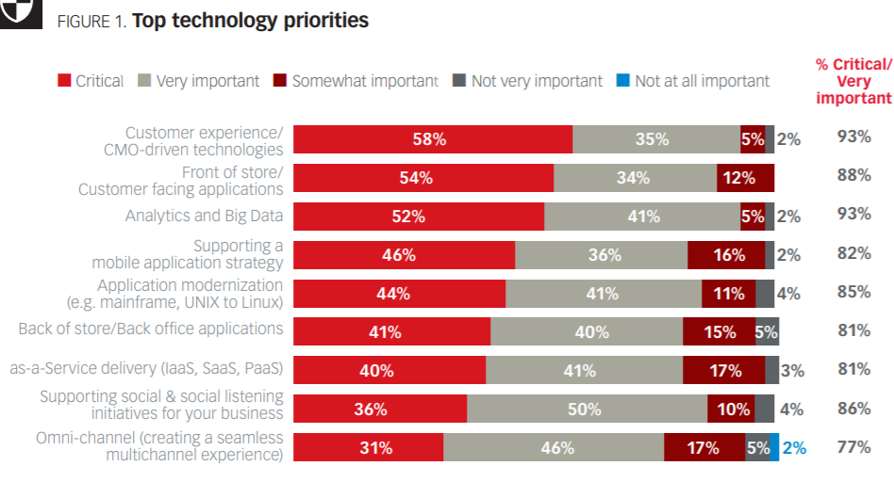
About the project?
White Paper, Dell Customer Experience
Problem Definition:
“To revamp the Dell Premier platform to improve customer experience and offer an elite experience for the customers”
Problem Keywords:
Personalisation Recommendations Caching
Customer experience is the top technology priority
Customer = Enterprise Customer

Slide 4
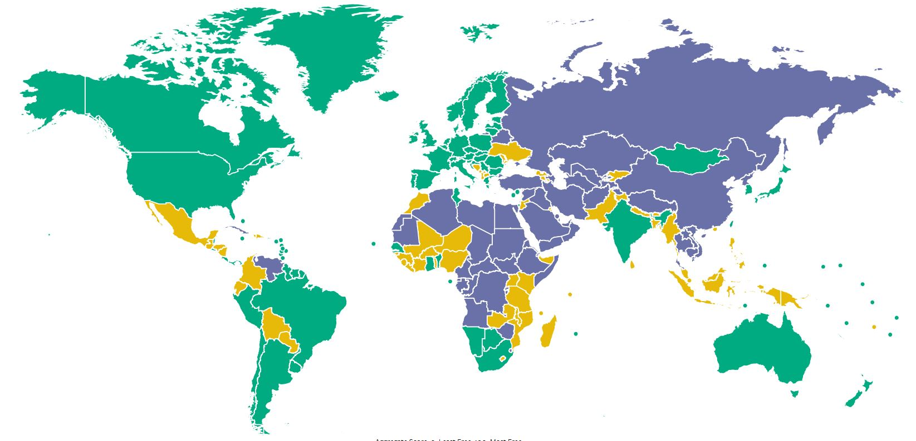

Problem Statement - One
“Provide a super fast rendering experience to user”
Delta Smart Caching - Cache top three recommendations
Laptop
Desktop
Workstations
Servers
To render UI pages instantly using pre-fetch. Most likely to click on these.
Faster user experience means better satisfaction → more involvement

Slide 5
Problem Statement - Two
“Recommendation for existing customers with a history of transactions.”
Content Based Recommendation System
Similarity Score
Delta Caching
Traditional machine learning approaches require more data
Customer satisfaction, Retain existing customers

Slide 6
Problem Statement - Three
“Recommendation for new enterprises with no past history.”
Two Levels of Recommendation: Demographic and Sector-Based
Education
Healthcare
Retail Stores
Bank
Enterprises within a sector have similar needs. Demography also has a huge effect.
Customer satisfaction, Relevant data will attract new enterprises

Slide 7
Problem Statement - Four
“Personalise theme as per company and role of the person accessing.”
Personalise different first page for every role. Change theme as per company logo color.
Platform Color
Shopper
Buyer
Executive/Admin
Company logo = best inspiration to customize. Relevant data for relevant roles.
Ease of access for different employees, chances of more interaction -> more business

Slide 8
Problem Statement - Five
Harvard Business Review, 2012
“72.1% of consumers spend most or all of their time on websites in their own language.”
Make the application translatable
प्रधान
总理
പ്രീമിയർ
প্রধান
Not feasible due to time-constraint
“72% report they are more likely to buy once they see product in their language”

Slide 9
Problem Statement - Six
Providing a better environment for Executives to make decisions effortlessly
Data Summarization and Visualization
Collection
Cleanup
Analysis
Visualization
Not feasible due to data-constraint
Will attract customers, especially small-business owners

Slide 10






Technologies Employed in Full Stack Development

Slide 11

Use Cases

Slide 12
Use Cases
Courtesy: Vysor - Cast Mobile onto Laptop Screen
 | Customer Creation - Platform Color Personalization + Shopper + Recommendations
 | Customer logs in as Shopper, Personalised Experience
 | Customer logs in as Admin, Personalised Experience + Statistical summary
 | Customer belongs to Education sector, Demographic + Sector based Recommendations
 | Customer is based in Singapore, Demographic + Sector based Recommendations
 | Customer logs in, Shown Recommendations, Details are pre-computed (Delta Caching)

Slide 13
Team Delta - Unique Selling Points
Demographic and Sector-Based Recommendation: can significantly improve first time recommendations
Company Logo Personalisation: home-like feeling with personalised company colors
Delta Smart Caching: cache the top 3 recommended items to render instantly
Employee Role Customization: screen customized as per the employee rule
Admin Portal with Data Analytics Service: understand budget, expenditure details in a visual manner

Slide 14
Q&A

Slide 15
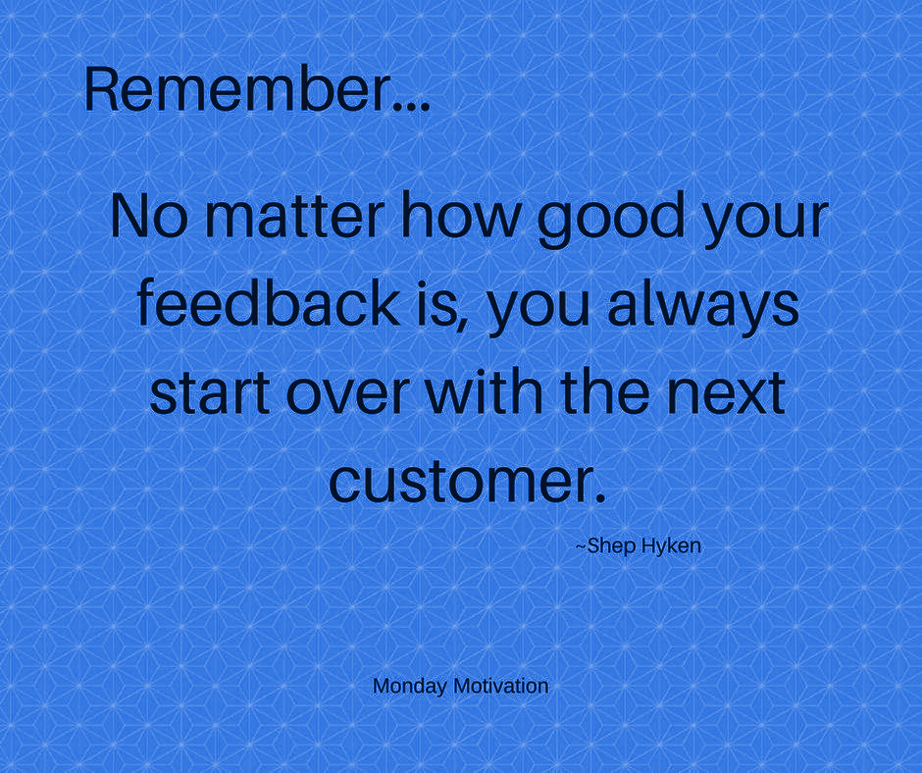
Thanks!

